Slide 1
Constraint Satisfaction Problems
Reading: Chapter 5

Slide 2
Constraint satisfaction problems (CSPs)
Standard search problem:
  state is a "black box“ – any data structure that supports successor function, heuristic function, and goal test
CSP:
  state is defined by variables X_{i} with values from domain D_{i}
  goal test is a set of constraints specifying allowable combinations of values for subsets of variables
  E.g. graph colouring, N-queens
Simple example of a formal representation language
Allows useful general-purpose algorithms with more power than standard search algorithms

Slide 3
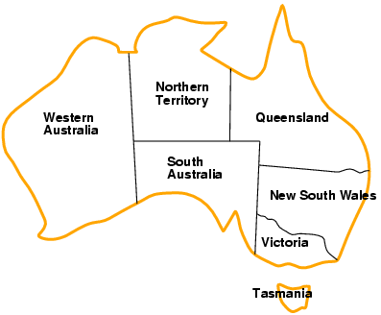
Example: Map-Coloring
Variables WA, NT, Q, NSW, V, SA, T
Domains D_{i} = {red,green,blue}
Constraints: adjacent regions must have different colors
e.g., WA ≠ NT, or (WA,NT) in {(red,green),(red,blue),(green,red), (green,blue),(blue,red),(blue,green)}

Slide 4
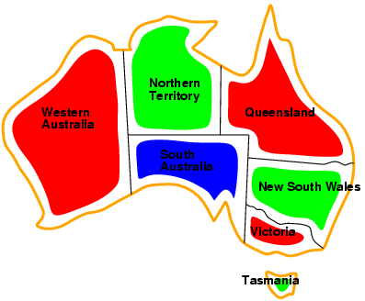
Example: Map-Coloring
Solutions are complete and consistent assignments, e.g., WA = red, NT = green,Q = red,NSW = green,V = red,SA = blue,T = green

Slide 5
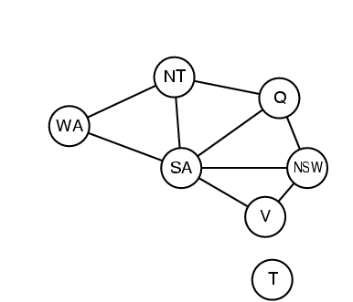
Constraint graph
Binary CSP: each constraint relates two variables
Constraint graph: nodes are variables, arcs are constraints
Colouring has many uses:
including bandwidth
assignment in mobile-phone
masts

Slide 6
Varieties of CSPs
Discrete variables
  finite domains:
    n variables, domain size d → O(d^{n}) complete assignments
    e.g., Boolean CSPs, incl.~Boolean satisfiability (NP-complete)
  infinite domains:
    integers, strings, etc.
    e.g., job scheduling, variables are start/end days for each job
    need a constraint language, e.g., StartJob₁ + 5 ≤ StartJob₃
Continuous variables
  e.g., start/end times for Hubble Space Telescope observations
  linear constraints solvable in polynomial time by linear programming

Slide 7
Varieties of constraints
Unary constraints involve a single variable,
  e.g., SA ≠ green
Binary constraints involve pairs of variables,
  e.g., SA ≠ WA
Higher-order constraints involve 3 or more variables,
  e.g., cryptarithmetic column constraints

Slide 8
Real-world CSPs
Assignment problems
  e.g., who teaches what class
Timetabling problems
  e.g., which class is offered when and where?
Transportation scheduling
Factory scheduling
Note that many real-world problems involve real-valued variables

Slide 9
Standard search formulation (incremental)
Let's start with the straightforward approach, then fix it
States are defined by the values assigned so far
Initial state: the empty assignment { }
Successor function: assign a value to an unassigned variable that does not conflict with current assignment
  → fail if no legal assignments
Goal test: the current assignment is complete
This is the same for all CSPs
Every solution appears at depth n with n variables
→ use depth-first search
Path is irrelevant, so can also use complete-state formulation
b = (n - l )d at depth l, hence #leaves= n!d^{n}, even though there are only d^{n} assignments

Slide 10
Backtracking search
Variable assignments are commutative}, i.e.,
[ WA = red then NT = green ] same as [ NT = green then WA = red ]
Only need to consider assignments to a single variable at each node
  b = d and there are d^{n} leaves
Depth-first search for CSPs with single-variable assignments is called backtracking search
Backtracking search is the basic uninformed algorithm for CSPs
Can solve n-queens for n ≈ 25

Slide 11
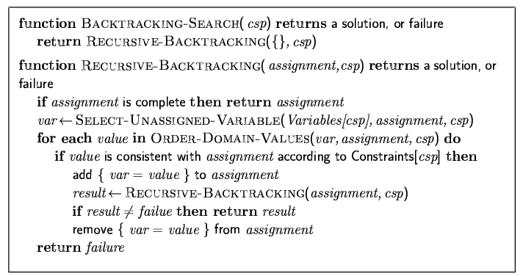
Backtracking search

Slide 12
Backtracking vs depth-first search?
Conceptually VERY similar
But in DFS we assumed that a node was expanded by applying all possible actions to add nodes to the fringe (then later, if nec, these nodes will be on the fringe ready to be expanded further)
Backtracking search just applies one action to produce one successor node, and continues on down (then later, if nec, on returning to this node it will check whether there are any other successors that can be generated)

Slide 13

Backtracking example

Slide 14
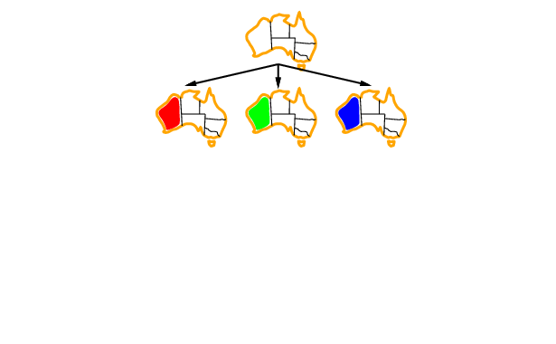
Backtracking example
….?

Slide 15
Backtracking example

Slide 16
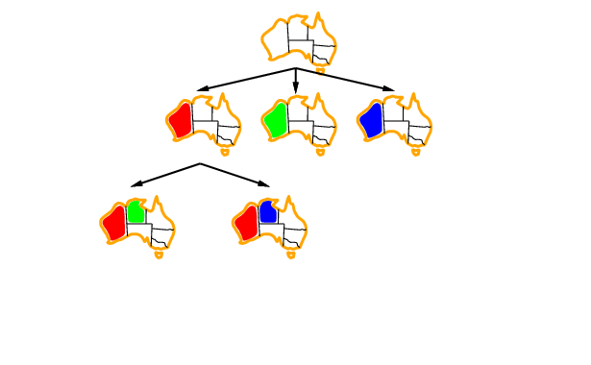
Backtracking example

Slide 17
Backtracking example
Is there a good reason to pick NT next rather than, say, NSW?

Slide 18
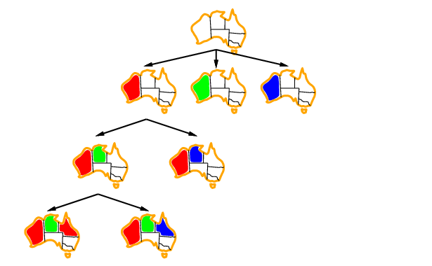
Backtracking example

Slide 19
Improving backtracking efficiency
General-purpose methods can give huge gains in speed:
  Which variable should be assigned next?
  In what order should its values be tried?
  Can we detect inevitable failure early?

Slide 20

Most constrained variable
Most constrained variable:
  choose the variable with the fewest legal values
a.k.a. minimum remaining values (MRV) heuristic
Because these are the variables that are most likely to prune the search tree (e.g. consider a variable with no legal values remaining)

Slide 21

Most constraining variable
Most constrained is more important heuristic, but most constraining is a useful tie-breaker among most constrained variables
Most constraining variable = the variable with the most constraints on remaining variables
  Because the variable involved in the most constraints -> is again, most likely to cause a failure early/prune the search tree

Slide 22
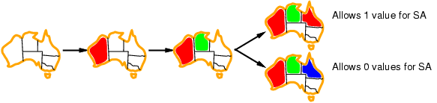
Least constraining value
Given a variable, choose the least constraining value:
  the one that rules out the fewest values in the neighbouring variables – to leave other variables as open as possible
Combining these heuristics makes 1000 queens feasible

Slide 23
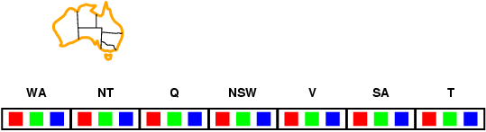
Forward checking
Idea:
  Keep track of remaining legal values for unassigned variables
  Terminate search when any variable has no legal values

Slide 24
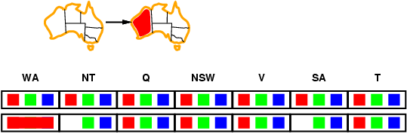
Forward checking
Idea:
  Keep track of remaining legal values for unassigned variables
  Terminate search when any variable has no legal values

Slide 25
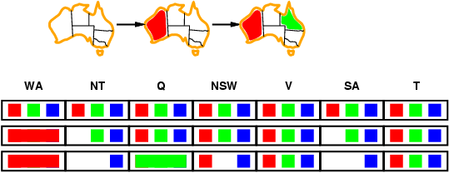
Forward checking
Idea:
  Keep track of remaining legal values for unassigned variables
  Terminate search when any variable has no legal values

Slide 26
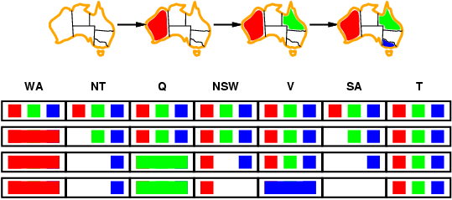
Forward checking
Idea:
  Keep track of remaining legal values for unassigned variables
  Terminate search when any variable has no legal values
Detects failure because no options remain for SA

Slide 27
Constraint propagation
Forward checking propagates information from assigned to unassigned variables, but doesn't provide early detection for all failures:
NT and SA cannot both be blue! – we would find this out eventually via search, but is there a faster way?
Constraint propagation repeatedly enforces constraints locally

Slide 28
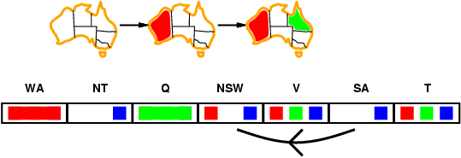
Arc consistency
Simplest form of propagation makes each arc consistent
X →Y is consistent iff for every value x of X there is some allowed y

Slide 29
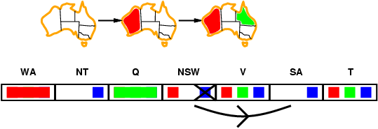
Arc consistency
Simplest form of propagation makes each arc consistent
X →Y is consistent iff for every value x of X there is some allowed y

Slide 30
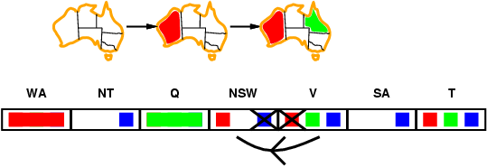
Arc consistency
Simplest form of propagation makes each arc consistent
X →Y is consistent iff for every value x of X there is some allowed y
If X loses a value, neighbors of X need to be rechecked

Slide 31
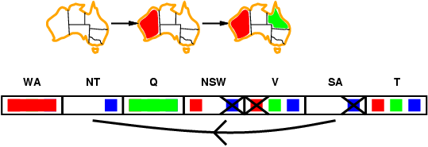
Arc consistency
Simplest form of propagation makes each arc consistent
X →Y is consistent iff for every value x of X there is some allowed y
If X loses a value, neighbors of X need to be rechecked
Arc consistency detects failure earlier than forward checking

Slide 32
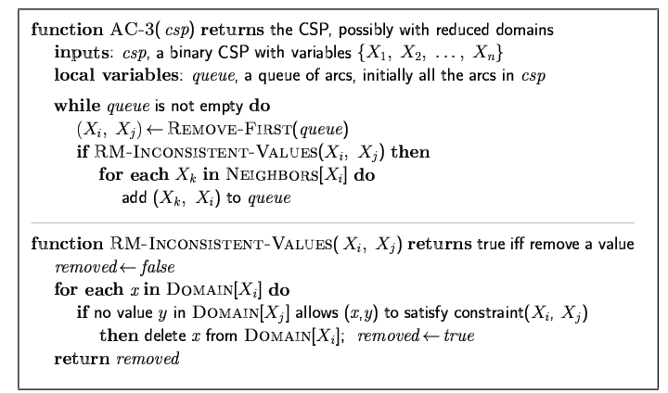
Arc consistency algorithm AC-3
Time complexity: O(n²d³)

Slide 33
Local search for CSPs
Hill-climbing, simulated annealing typically work with "complete" states, i.e., all variables assigned
To apply to CSPs:
  allow states with constraint violations
  operators reassign variable values
Variable selection: randomly select any conflicted variable
Value selection by min-conflicts heuristic:
  choose value that violates the fewest constraints
  i.e., hill-climb with h(n) = total number of violated constraints

Slide 34
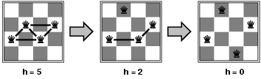
Example: 4-Queens
States: 4 queens in 4 columns (4⁴ = 256 states)
Actions: move queen in column
Goal test: no attacks
Evaluation: h(n) = number of attacks

Slide 35
Iterative Min-Conflicts
While we are not at a solution:
  Choose a random conflicted variable
  Pick a value for this that has minimum conflicts
Works surprisingly well (on N-queens)!
  For n-queens, almost independent of problem size - due to dense solution space
  Also works on scheduling problems
    Note: No need to restart and re-run backtracking…

Slide 36
Summary
CSPs are a special kind of problem:
  states defined by values of a fixed set of variables
  goal test defined by constraints on variable values
Backtracking = depth-first search with one variable assigned per node
Variable ordering and value selection heuristics help significantly
Forward checking prevents assignments that guarantee later failure
Constraint propagation (e.g., arc consistency) does additional work to constrain values and detect inconsistencies
Iterative min-conflicts is usually effective in practice

